Slide 1

Face Recognition Based Automatic Attendance Recording System using Deep Learning Libraries.
Raghu Murugankutty – W20024451
MSc. Data Science with Advanced Practice
Northumbria University
24-Jan-2024

Slide 2
Agenda
Introduction
Literature Review
Research Methodology
System Design
Implementation Phase
Testing and Validation
Challenges and Solutions
Conclusion
Future Work and Recommendations

Slide 3
Introduction
Importance of Automatic Face Recognition System
Enhances Efficiency: Automatic face recognition systems streamline attendance recording processes, saving time and reducing the risk of errors, ultimately leading to improved efficiency in educational and organizational settings.
Challenges Faced by Existing Technologies
Limited Accuracy: Previous methods of attendance systems, such as manual roll calls or card-based systems, often suffered from limited accuracy, making them susceptible to errors like proxy attendance or time manipulation.
Face Recognition Based Automatic Attendance Recording System using Deep Learning Libraries Real-time Accuracy: This system provides real-time and highly accurate attendance recording, eliminating the need for manual tracking and reducing errors in attendance data.

Slide 4
Literature Review
Traditional Attendance recording systems and Techniques
Attendance recording has a long history, evolving from manual methods like paper registers to early digital systems.
Earlier systems were susceptible to errors and manipulation, necessitating advancements in technology.
Verbal Confirmation, Manual Roll Call, Paper-Based Registers, Time Clocks, Punch Cards, etc.
Advancements and Challenges
Accuracy Advancements: Deep learning libraries enhance face recognition system accuracy.
Privacy and Ethics Challenges: Ethical and privacy concerns pose challenges.
Diverse Applications: Face recognition extends beyond security to various real-world uses.
Motivations for Deep learning Automatic face recognition system
Modernization Urgency: Conventional attendance methods are error-prone and burdensome, requiring modernization.
Accuracy and Efficiency: Facial recognition enhances accuracy, reduces errors, and saves time.
Transformational Technology: The thesis showcases tech's transformative role in education, promoting data-driven innovation in attendance recording.
Impact on Automatic Face Recognition System
Enhanced Security: Automatic face recognition systems bolster security measures by providing a robust means of identity verification.
Improved Efficiency: The automation of identity verification processes saves time and resources, increasing operational efficiency.
Data-Driven Insights: These systems generate valuable data for analysis, aiding in decision-making and personalized user experiences.

Slide 5
Research Methodology
System Design
The research methodology begins with the design of the Deep learning based Automatic face recognition system. This involves defining the system requirements and architecture.
System Development
Collected facial images for dataset creation.
Employed a pre-trained algorithm for facial recognition.
Utilized a webcam to capture real-time facial images.
Employed Firebase for data storage and retrieval.
Data Collection and Analysis
To gather data for training and testing the face recognition AI model, a comprehensive approach is employed. This includes the collection of real-world facial images for model training and validation purposes.
Testing and Validation
Rigorously tested the system under diverse lighting conditions and various facial positions to validate its accuracy and performance.
Ethical Considerations
Throughout the research process, ethical considerations are considered. This includes ensuring the privacy and security of the collected data, obtaining informed consent from participants, and adhering to relevant ethical guidelines and regulations.

Slide 6
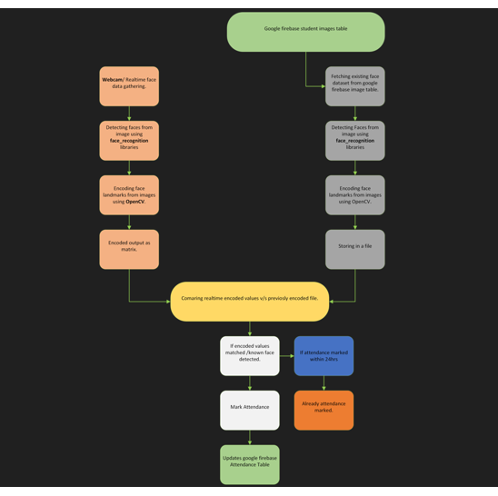
System Design
Architectural Diagram
The system employed a pre-trained face recognition algorithm.
Real-time facial capturing was achieved using a webcam.
Firebase served as the real-time database for data storage and retrieval.

Slide 7
Implementation Phase
Development Environment and Tools
Tool | Description
Programming Languages | Python
Frameworks | OpenCV
Database | Firebase
Version Control | Git
IDE | Pycharm
Communication | Teams
Development Workflow and Agile SCRUM
Phase | Description
Planning | Defining project goals, requirements, and user stories
Sprint Planning | Breaking down user stories into tasks and estimating effort
Development | Implementing features and functionality based on the user stories
Testing | Conducting smoke testing, functionality testing, integration testing, and user acceptance testing
Review and Feedback | Gathering feedback from testers and making necessary adjustments

Slide 8
Testing and Validation
Methods of Testing
Functional Testing: This testing ensures that all system functionalities are working as intended.
Integration Testing: Integration testing verifies that different software components seamlessly work together.
System Testing: System testing validates the entire face recognition system against the specified requirements.
Performance Testing: Performance testing evaluates the system's performance under various lighting conditions, assessing its responsiveness and scalability.

Slide 9
Challenges
Technical Challenges Faced
Encountered challenges while attempting to implement a web application with an admin dashboard for dashboard customization. Specifically, faced difficulties in formatting and reading the face recognition tags using HTML tags.
Faced difficulties in the application testing with huge number of different application testers.

Slide 10
Conclusion
Effectiveness of the Automatic face recognition system compared to traditional methods
High Accuracy: The automatic face recognition system consistently achieves high levels of accuracy in identifying individuals.
Efficiency and Speed: It significantly improves efficiency by automating attendance recording and performs real-time recognition rapidly.
Enhanced Security: The system enhances security by providing a reliable means of identity verification, reducing the risk of unauthorized access.

Slide 11
Future Work and Recommendations
Suggestions for Future Development
Advanced Deep Learning Models: Future development should explore state-of-the-art deep learning models to further enhance accuracy and efficiency in facial recognition.
Enhanced User Experience: Consider adding features like an intuitive admin dashboard, a mobile app for self-service, and a notification system for attendance updates to improve the user experience.
Robust Security Measures: Explore anti-spoofing techniques and collaborate with cybersecurity experts to enhance system security, safeguard against attacks, and protect against unauthorized access.

Slide 12
Demo

